Slide 1
AI Governance…

Slide 2
AI Governance – the Why
AI governance is the engineered set of decision rights, controls, measurements, and escalation mechanisms that ensures AI systems (and the organisations deploying them) behave within an agreed risk appetite while meeting legal, security, safety, quality, and business objectives.
For generative AI (GenAI), governance must treat the model as a probabilistic, prompt-programmable component whose behaviour depends heavily on data, tooling connections (RAG/agents), and operational context—so governance has to be end‑to‑end: from data provenance and training, through deployment and runtime observation, to incident response and post‑mortems.
Notes:
How to start an AI governance presentation (impactful “why”)
Your opener should reframe governance as a speed enabler, not a brake.
The 45-second cold open (script)
“AI isn’t just software that can be wrong. It’s software that can be confidently wrong, and now it can act—call tools, move money, change customer experiences, leak data—at machine speed. So the core problem isn’t accuracy. It’s the AI’s action radius. AI governance is how we keep the action radius bounded while still shipping fast.”
Then hit the thesis (one sentence)
“Governance is how we scale AI velocity with bounded risk and auditable control.

Slide 3
Governance is…
“Governance is not compliance. It’s reliability engineering for socio-technical systems.”
“If you can’t measure it (e.g., eval pass rates, drift, incident MTTR), you don’t govern it.”
“The goal isn’t ‘no risk’—it’s explicit risk with bounded blast radius.”

Slide 4
AI Governances as AI Control Plane
A modern GenAI governance stack should be a control plane across the AI lifecycle, not a committee. It includes: (1) clear decision rights and risk acceptance; (2) complete asset inventory (models, prompts, datasets, tools, endpoints, policies); (3) use-case risk tiering and gated approvals; (4) data governance (provenance/licensing, PII, retention/redaction; for RAG: source allowlists + freshness/citation rules); (5) evaluation gates and regression CI (capability, safety, security, privacy) for every release; (6) runtime enforcement (policy-as-code, least-privilege tool access, sandboxing, human-in-the-loop for high-impact actions); (7) observability and audit (end-to-end traces incl. retrieval/tool calls, tamper-resistant logs); (8) supply-chain and vendor controls; and (9) GenAI incident response (prompt/response forensics, retrieval traceability, kill-switch/rollback, post-incident updates and learning loops).

Slide 5
AI Governances as AI Control Plane
A modern GenAI governance stack should be a control plane across the AI lifecycle, not a committee. It includes:
(1) clear decision rights and risk acceptance
(2) complete asset inventory (models, prompts, datasets, tools, endpoints, policies);
(3) use-case risk tiering and gated approvals
(4) data governance (provenance/licensing, PII, retention/redaction; for RAG: source allowlists + freshness/citation rules)
(5) evaluation gates and regression CI (capability, safety, security, privacy) for every release
(6) runtime enforcement (policy-as-code, least-privilege tool access, sandboxing, human-in-the-loop for high-impact actions)
(7) observability and audit (end-to-end traces incl. retrieval/tool calls, tamper-resistant logs)
(8) supply-chain and vendor controls
(9) GenAI incident response (prompt/response forensics, retrieval traceability, kill-switch/rollback, post-incident updates and learning loops).

Slide 6
Control patterns (what these stories really teach)
A compact governance stack you can operationalize
1) Permissioning & isolation
• Least privilege for tools
• Prod/dev separation
• Scoped tokens + allowlists
2) Release gates (LLM CI)
• Eval suites + thresholds
• Canaries + rollbacks
• Change control for prompts/models
3) Data governance
• Provenance tiers
• PII redaction / DLP
• Retention + audit trails
4) Runtime enforcement
• Policy checks on tool calls
• Output validation
• Monitoring + kill switch
5) Evidence & accountability
• RACI + sign-offs
• Incident playbooks
• Audit-ready artifacts
AI Governance Stories
Notes:
Use this slide as the “so what?” after 2–3 stories. It converts anecdotes into an operating system. [Sources] - OWASP LLM Top 10 (risk taxonomy used to inform common control categories): https://owasp.org/www-project-top-10-for-large-language-model-applications/ - UK NCSC prompt injection framing (runtime enforcement emphasis): https://www.ncsc.gov.uk/blog-post/prompt-injection-is-not-sql-injection

Slide 7
The Power Shift
The power shift
LLMs moved from text generation to decision shaping to tool use/agents.
That increases blast radius: one prompt → many downstream actions.
The failure mode shift
Traditional software fails deterministically. AI fails probabilistically, contextually, and adversarially (prompt injection, data poisoning, jailbreaks).
Failures are harder to reproduce → you need evidence-based gates and runtime controls. legal and brand liability from ungoverned hallucinations
The business consequence
Without governance you get: blocked deployments, reputational damage, compliance fire drills, and “shadow AI.”
With governance you get: faster approvals, safer autonomy, measurable quality, and trust.
Notes:
The first 5 slides (minimal, high-impact)
Title + thesis: “Scaling AI with bounded risk”
Action radius diagram: Model → tools → data → users → money (show blast radius)
What governance is / isn’t (1 slide: not bureaucracy; it’s operating discipline)
Lifecycle gates: Ideation → Build/Buy → Eval → Deploy → Run → Incident → Retire
Your governance primitives: policies, permissions, eval thresholds, audit evidence

Slide 8
AI governance = organisational governance + technical assurance.
Organisationally, governance sets accountability, roles, decision rights, and assurance obligations;
Technically, it creates the measurement, control, and traceability mechanisms that make those obligations testable and auditable
“safety” must be operationalised as measurable requirements tied to explicit risk scenarios and evaluation sets, not as an undifferentiated global filter.
Notes:
“safety” must be operationalised as measurable requirements tied to explicit risk scenarios and evaluation sets, not as an undifferentiated global filter.

Slide 9
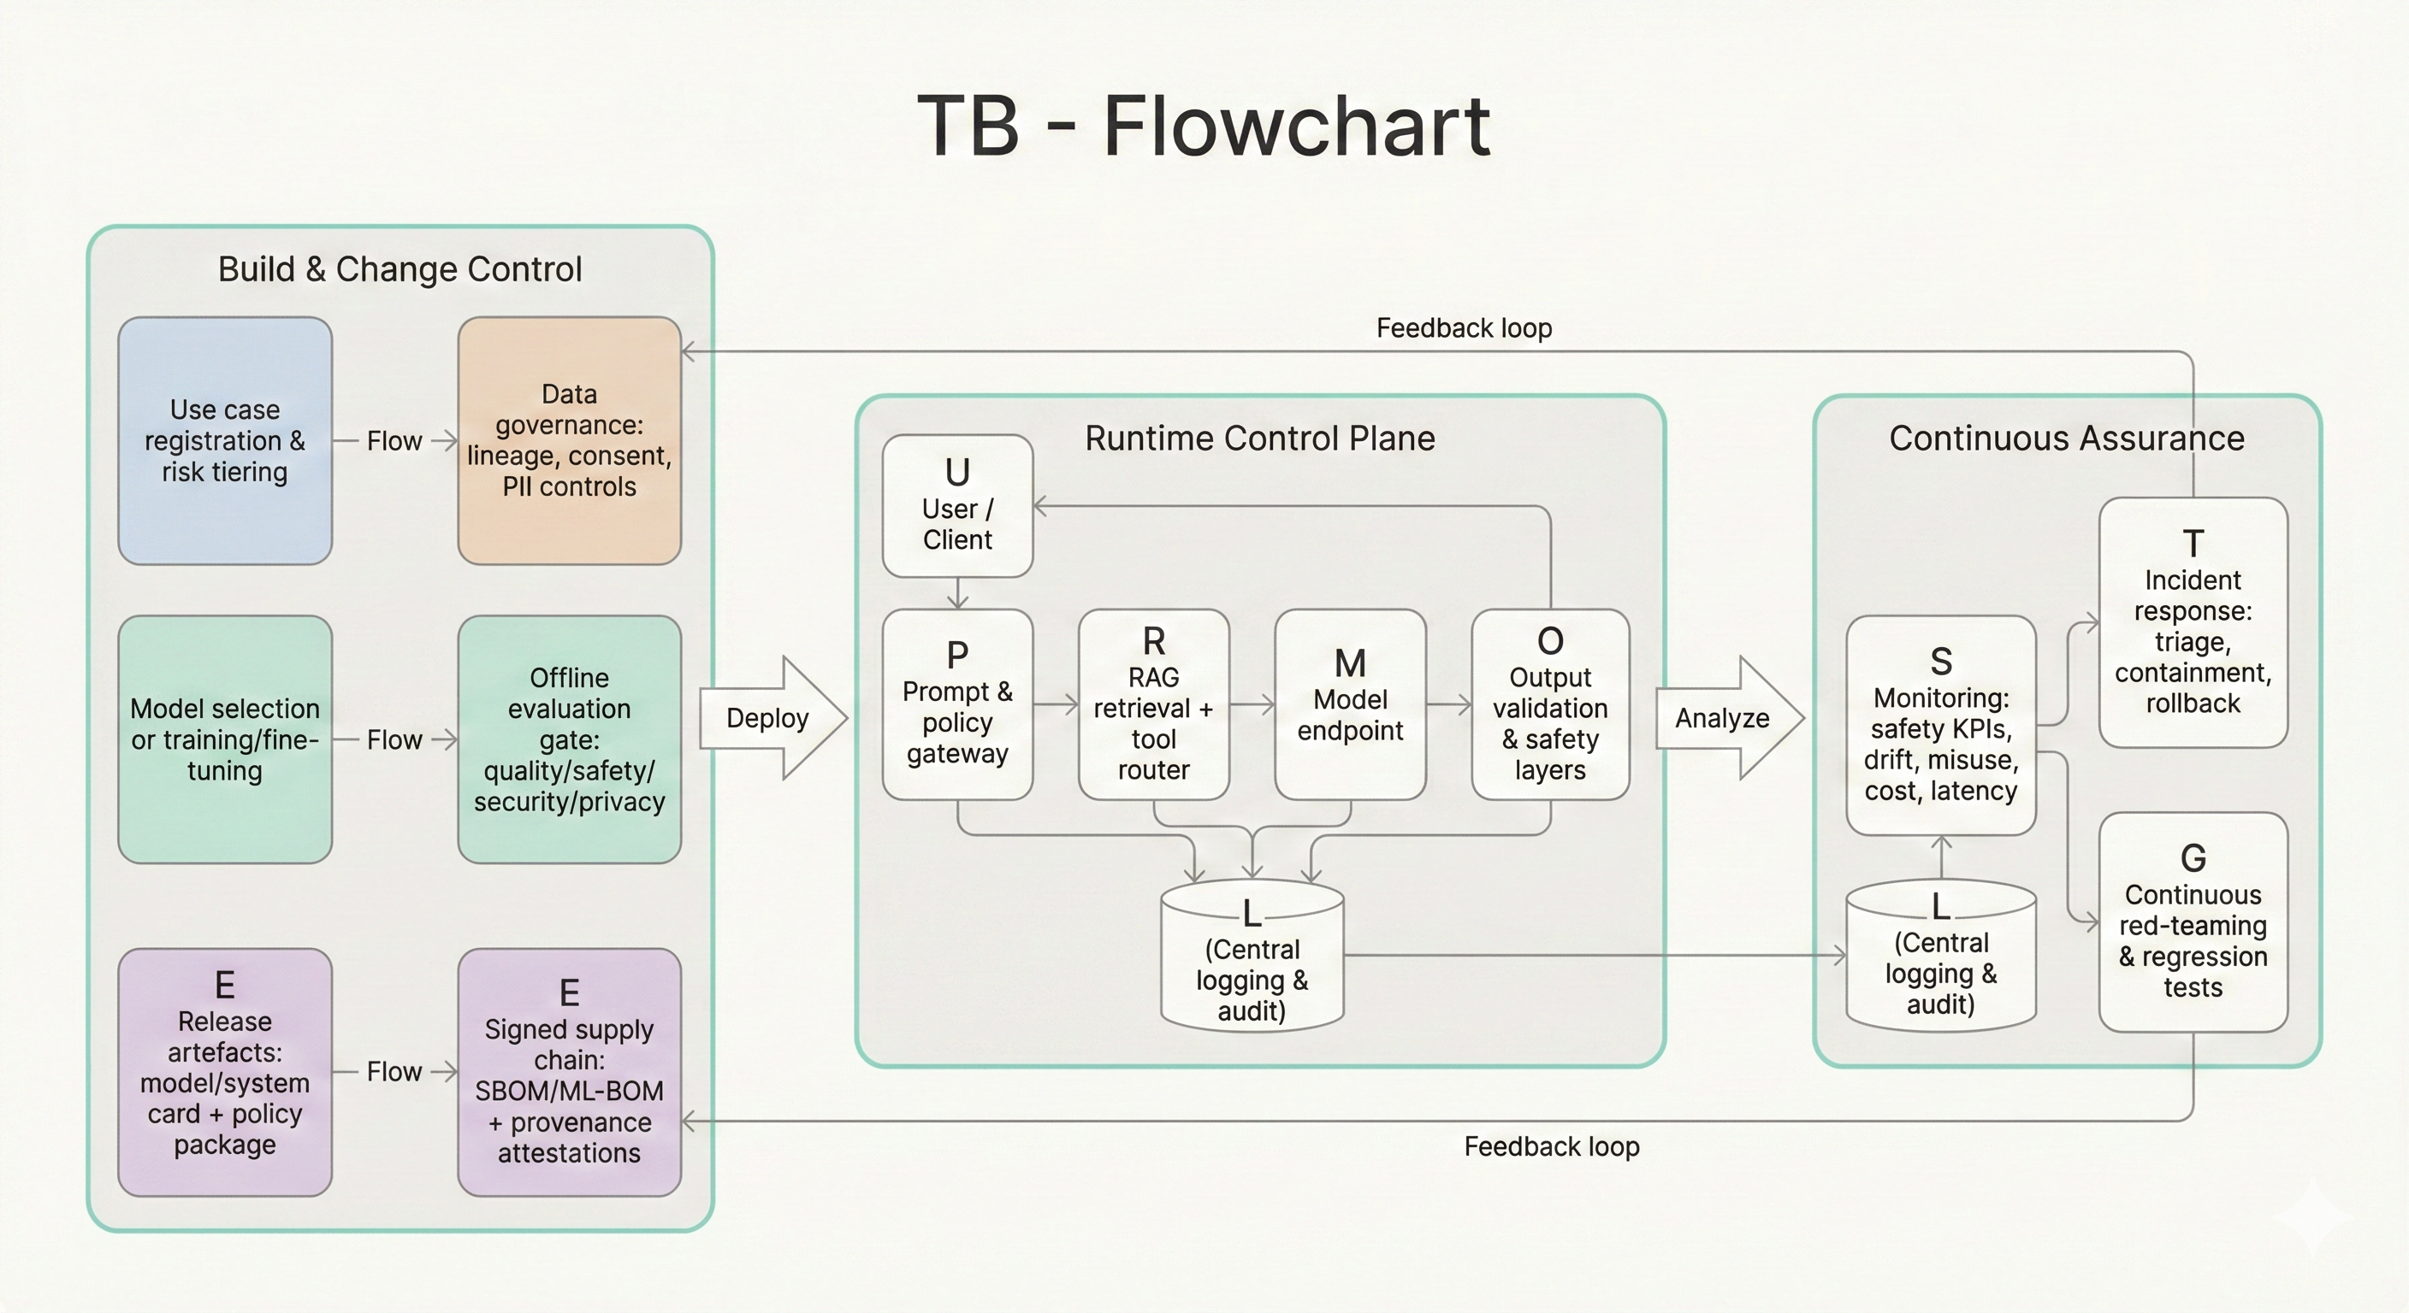

Slide 10
AI Governance Scope
For generative AI, “scope” must be broad because risk is often introduced outside the core model
weights. In GenAI systems, the effective behaviour arises from the combination of: (a) the foundation
model (capabilities, training distribution, post‑training), (b) the orchestration layer (prompt templates,
tool routing, policies), (c) external knowledge sources (RAG corpora, enterprise documentation), and (d)
runtime context (user intent, authentication status, environment permissions)

Slide 11
AI Governance
System Governance –
Model Governance
Data Governance
Operational Governance
Supply-chain Governance
Notes:
•
•
•
•
•
System governance (end-to-end): governance for the application (chatbot/agent/workflow), not
merely the base model. This is where prompt injection, insecure tool use, and data leakage
occur.
8
Model governance: selection, fine-tuning, post‑training, evaluation, release, and deprecation;
documentation via model/system cards and safety frameworks.
9
Data governance: training data provenance and legality; personal data controls; sensitive data
access; dataset documentation (datasheets) and quality measures.
10
Operational governance: monitoring, logging, incident response, reliability engineering, and
cost controls in production.
11
Supply-chain governance: software and model dependency transparency and integrity (SBOM/
attestations, SLSA provenance, AI/ML BOM concepts)

Slide 12
Content Authenticity
Content authenticity and communications infrastructure. The FCC proposed enforcement actions and significant fines for apparently illegal robocalls using AI-generated voice cloning around the New
Hampshire primary, highlighting that synthetic media can be operationalised quickly for deception at scale. From a governance viewpoint, this connects directly to provenance, watermarking, and platform disclosure obligations: governance must include supply chains for media authenticity, not just model behaviour.

Slide 13
Indirect Prompt Injections
The most important “technical incident class” for GenAI applications is indirect prompt injection in RAG/agentic systems. Policy-facing security research from CETaS explains indirect prompt injection as malicious instructions inserted into data sources that a GenAI system will later ingest (emails, documents, web pages), allowing an attacker to steer behaviour without direct access to the prompt interface. This shifts the security model: your retrieval corpus and tool inputs become part of the model’s “programmable surface”, so governance must treat them like untrusted code. This is further reinforced by OWASP’s GenAI security work, which places prompt injection at the top of LLM application risks, and by the broader ecosystem’s threat catalogues (e.g., MITRE ATLAS)

Slide 14
Data Governance for GenAI

Slide 15
Implementation Patterns
Use a policy gateway that mediates every request and tool call; do not let the model directly hold high-privilege credentials.
Implement capability-based tool permissions (per-user, per-session tokens; scoped API keys; just-in- time access).
Add action confirmation for high-impact operations (payments, record deletion) and sandbox tools that interpret untrusted content (e.g., web browsing, file parsing) to limit indirect prompt injection damage.
Trade-offs: strict controls reduce “agent autonomy” and can increase latency; but they cap worst-case outcomes. In practice, the ROI is usually positive because a single exfiltration incident can dominate costs.

Slide 16
Evaluation, metrics, and red-teaming (turning intent into measurable gates)
Technical explanation: GenAI governance cannot rely on traditional ML accuracy alone; you need multi-dimensional evaluation: capability, robustness, safety, security, privacy, and operational performance.
Implementation patterns:
Maintain evaluation suites by risk scenario (e.g., misinformation, medical advice, self-harm content, financial fraud, data exfiltration, jailbreaks).
Use regression gates in CI: no deploy if safety/security KPIs regress above threshold.
Run continuous red-teaming with tools that probe for known failure modes and system-specific vulnerabilities (prompt injection, data leakage, tool misuse).
Tooling/library examples (open-source-first where possible):
Inspect (LLM evaluation framework).
Garak (LLM vulnerability scanner; 2026 docs show active evolution).
Promptfoo (prompt/agent/RAG testing + CI integration).
Metrics
Policy violation rate (unsafe content, disallowed actions) and jailbreak success rate on canonical test packs.
Grounding / faithfulness (answer supported by retrieved sources) in RAG.
PII leakage rate (detected sensitive strings/entities in outputs).
Operational: latency distribution, cost per successful task, tool-call error rate.
Notes:
Business implications: evaluation gates are a direct cost (compute, staff time) but reduce incident
frequency and improve product stability; they also become part of compliance evidence (especially as
GPAI documentation and testing expectations consolidate)

Slide 17
Safety layers and content policy enforcement (defence-in-depth)
Technical explanation: “model alignment” is not enough; production safety is a layered stack: pre‑prompt policies, input filters, model-level safety training, output filtering, and post‑processing validation. OpenAI’s system cards and preparedness framework describe layered approaches that combine evaluations, mitigations, and governance processes to determine whether deployment is acceptable.
Implementation patterns: define a safety policy package versioned like code (rules, thresholds, evaluator configs) and deploy it as a runtime “shield” around the model. For multimodal systems, ensure safety layers operate across modalities (text/audio/image) and are evaluated accordingly.
Trade-offs: safety layers create false positives (user friction) and can be bypassed if not tested adversarially; they also must be aligned with lawful use and policy.
Metrics: refusal rate vs “unsafe acceptance rate”; rate of safety-layer overrides; and red-team delta (“how many jailbreaks succeed”) before vs after a policy change.
Business implications: reduces legal/reputational exposure, improves trust; but over-restrictive filters can reduce adoption and ROI—so measure continuously.

Slide 18
Interpretability and assurance (what you can and cannot operationalise today).
Technical explanation: interpretability is moving from purely academic to partially operational for frontier governance, but remains expensive and imperfect. Recent work from Anthropic uses dictionary learning / sparse autoencoders to extract interpretable features from large models, explicitly discussing engineering challenges of scaling interpretability. OpenAI is exploring training weight-sparse transformers to yield more interpretable circuits, motivated by making mechanistic interpretability tractable.
Implementation patterns: treat interpretability as targeted assurance rather than a blanket requirement. Use it where you need stronger evidence: e.g., auditing unsafe tendencies, debugging misalignment in critical domains, or validating that safety “steering” is causally effective.
Trade-offs: cost and latency (interpretability research can be model-specific); governance value comes from carefully choosing which risks require mechanistic evidence, not from attempting full transparency.
Metrics: coverage of interpretability audits for high-risk behaviours; “steering effectiveness” (does manipulating identified features reduce harm without breaking utility); and reproducibility of findings across model versions.
Business implications: interpretability can provide differentiated assurance for regulators/partners and reduce catastrophic tail risk, but it is not yet a cheap compliance checkbox—budget it like security research.

Slide 19
Provenance, watermarking, and content authenticity (especially for media generation).
Technical explanation: provenance standards (like C2PA’s Content Credentials) encode signed claims and assertions about asset history and edits; watermarking technologies (like Google DeepMind’s SynthID) embed signals into generated content designed to survive transformations. NIST’s synthetic content work explicitly treats provenance metadata and digital watermarks as core technical approaches, alongside detection methods.

Slide 20
Post-training governance: RLHF, preference optimisation, and alignment techniques.
Technical explanation: RLHF aligns models by collecting human preference data and optimising model outputs to match labelled preferences; alternatives such as DPO simplify optimisation while targeting similar objectives. Governance matters because preference data encodes value judgments and can introduce systematic bias. Research is increasingly studying what values are embedded in RLHF datasets (e.g., “Value Imprint” for auditing RLHF datasets), and 2026 work explores preference aggregation methods tied to representative panels—highlighting that alignment is not value-neutral.
Notes:
Implementation patterns: define an explicit “alignment constitution” for the organisation (policy
principles, prohibited behaviours) and use it consistently across labeler guidelines, preference
aggregation, and safety evaluation. Maintain governance around: rater selection, annotation quality,
demographic coverage, and post‑training change management.
Trade-offs: alignment techniques can incur an “alignment tax” (compute, data, and potential capability
regressions), but reduce safety risk and harmful outputs. Governance should treat alignment as an
engineered optimisation problem with explicit constraints, not a black box.
8Metrics: preference-model agreement consistency, safety constraint satisfaction, and downstream
harmful-output reduction without unacceptable utility loss.
Business implications: alignment governance influences product liability, trust, and adoption; it also
becomes part of frontier risk frameworks (e.g., responsible scaling policies).

Slide 21
Secure deployment, DevSecOps, SRE, and incident response
Technical explanation: GenAI systems are software systems with new failure modes; governance must integrate with security engineering and reliability engineering rather than duplicating them. Supply chain integrity frameworks like SLSA define provenance and assurance levels for build artefacts; CISA’s evolving SBOM guidance reflects a maturing expectation that software component transparency is foundational for risk management.
Notes:
Implementation patterns:
- Use SBOM + attestations (provenance) and integrate them into CI pipelines.
71
- Treat model artefacts (weights, adapters, prompt packages) as deployable “binaries” with signing and
provenance.
72
- Maintain GenAI-specific incident response: prompt/response logs, retrieval traces, model version
pinning, immediate rollback/kill-switch, and post-incident eval expansions to prevent recurrence.
73
Trade-offs: stronger logging and traceability raise privacy/security burdens; you need strong access
control and retention policies (and possibly redaction) to make logs safe.
27
Metrics: MTTD/MTTR for GenAI incidents, “reproducibility rate” of incidents (can you replay the exact
prompt+context), change failure rate after prompt/model updates, and cost anomaly detection
accuracy.
74
Business implications: faster incident response reduces downtime and legal exposure; supply-chain
maturity becomes a procurement differentiator, especially when customers demand assurances for AI
components.

